Slide 1
End-to-End Compression of Video with Motion-Weighted Binarized Networks
Adrian D’Alessandro, Vignesh Vasudevan

Slide 2
Motivations

Slide 3
Learning Compression
Many compression algorithms for video are based on motion estimation and empirical experiments
It would be really useful to learn these compression algorithms, rather than rely on empirical observation
Many of the functions used in these algorithms are non-differentiable and thus cannot be used in neural networks.
Solving this problem is one of the most central focuses of the current compression literature.

Slide 4
Previous Work

Slide 5
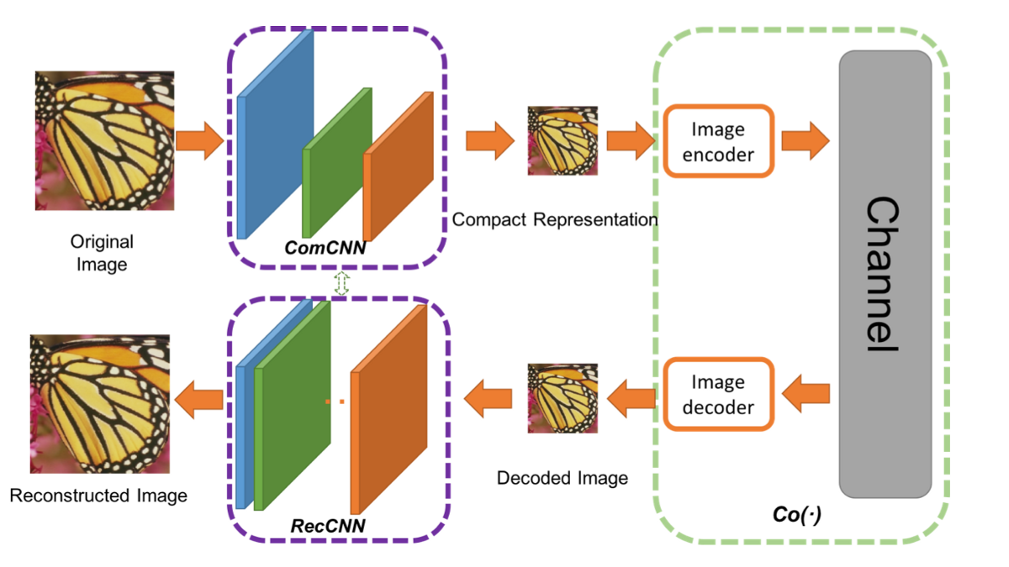
RecCNN & ComCNN

Slide 6
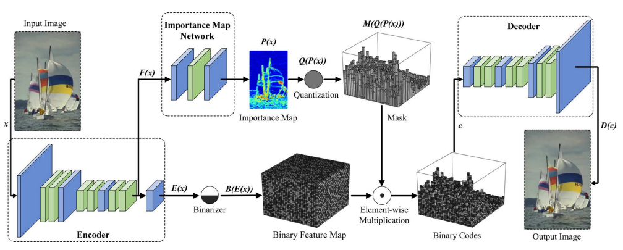
Content-Weighted Image Compression

Slide 7
Our Contribution

Slide 8
Our Starting Point: Apply this Architecture to Video

Slide 9
Architecture

Slide 10
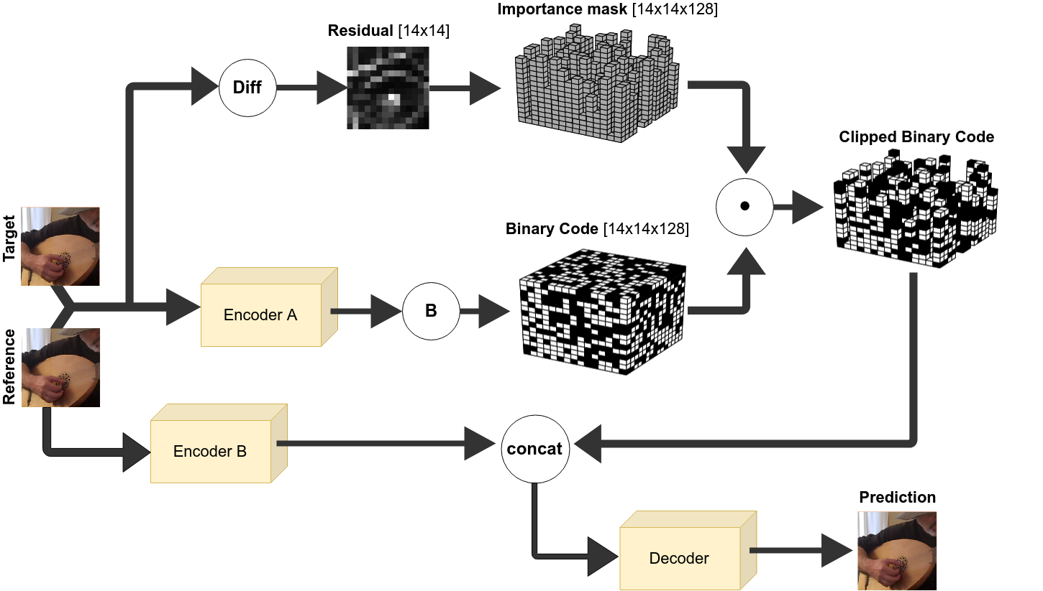

Slide 11
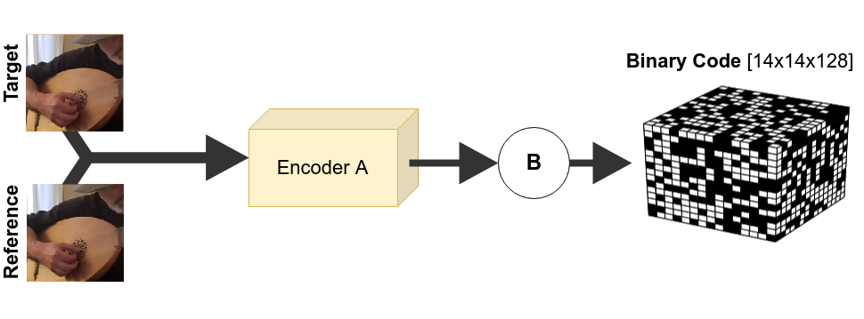
Encoder-A & Binarizer Formulation

Slide 12
Encoder-A & Binarizer Formulation
Encoder Purpose:
Learn a model for generating a 14x14x128 feature map which will hopefully represents how to recover the target from the reference (more on how we encourage this, later). Three proposed encoders studied in our research.
Binarizer Purpose:
Convert a feature map into a binary code of shape 14x14x128

Slide 13
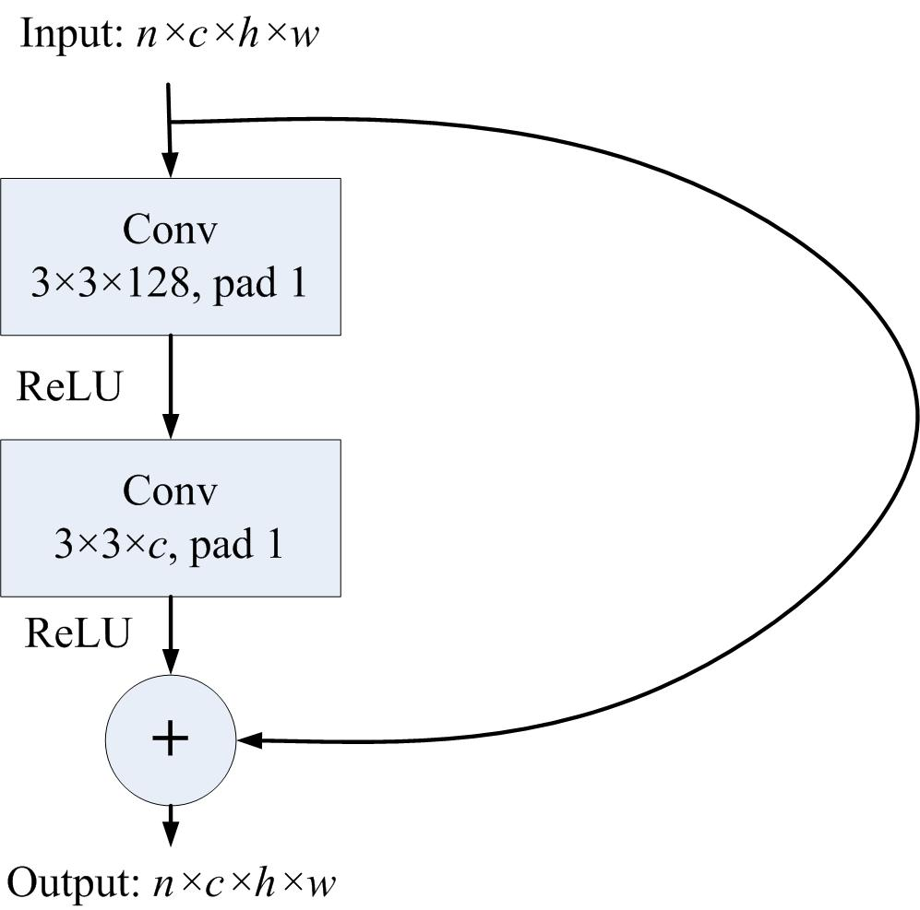
Encoder-A Architecture-1: Residual Layer, No BN
Reference [224x224x3]
Inputs concatenated before input into network
No pooling, no normalization
Target [224x224x3]
Residual Layer
112x112x128
Conv2d [4x4]
Residual Layer
56x56x128
Conv2d [4x4]
Residual Layer
28x28x128
Conv2d [4x4]
Residual Layer
14x14x128
Conv2d [4x4]
Residual Layer
Notes:
Residual Layer
ResNet50
FlowNetCorr (and intuition)

Slide 14
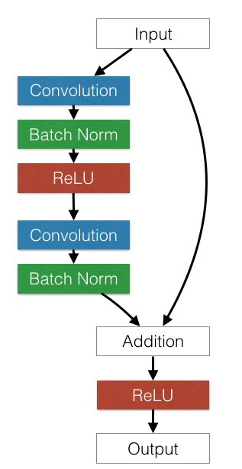
Encoder-A Architecture-2: ResNet50
We sample from a 50 layer residual network
Batch Normalization applied between convolutional layers and their activations
Notes:
Residual Layer
ResNet50
FlowNetCorr (and intuition)

Slide 15
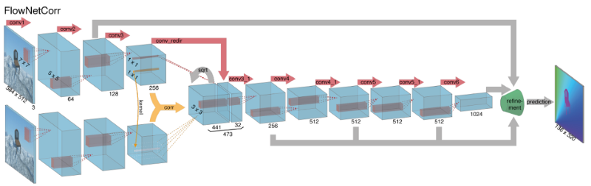
Encoder-A Architecture-3: FlowNetCorrelation
Generate features for each image separately
Convolve feature maps over each other
Max displacement: 16
Steps: 1x1
Notes:
Residual Layer
ResNet50
FlowNetCorr (and intuition)

Slide 16
Binarized Networks: The Differentiation Problem
If we can convert a feature map into some binary representation, we can learn codes representing the motion in the image that can potentially be compressed.
However, as we know, functions that threshold their input are frequently not differentiable (like the round function). This is a problem.

Slide 17
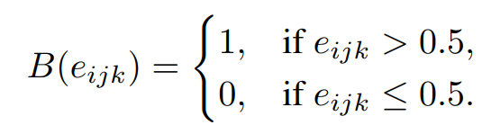
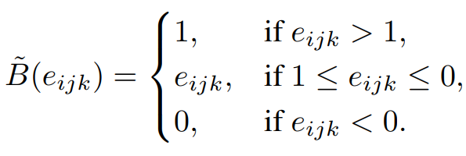
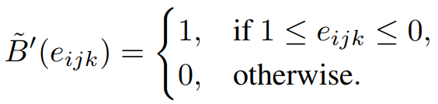
Binarized Networks: Straight-Through Estimators
Binarized networks first established in the literature in 2016^{[1]}.
Made possible by “Straight-Through Estimators”, which were conceived of in a 2013 paper^{[2]}.
Empirically discovered thresholding incoming gradient and disregarding real gradient works.
Given a mathematical explanation in 2019^{[3]}.
Notes:
Introduce Straight-Through Estimation
Bits per pixel
With features represented in a [14x14x128] tensor, pixels = 224*224, bpp = 14*14*128/pixels = 0.5 bpp
Each channel represents a [16x16x3] patch in the original image i represented by 0.5*16*16 = 128 bits

Slide 18
Binarized Network: Bits Per Pixel
A useful concept for understanding compression in this environment is bits per pixels
Consider the binary code below, which has 14 x 14 x 128 = 25,088 bits
The target image has 224x224 pixels
Bits Per Pixel = (14x14x128) ➗ (224x224) = 0.5 bpp

Slide 20


Slide 21
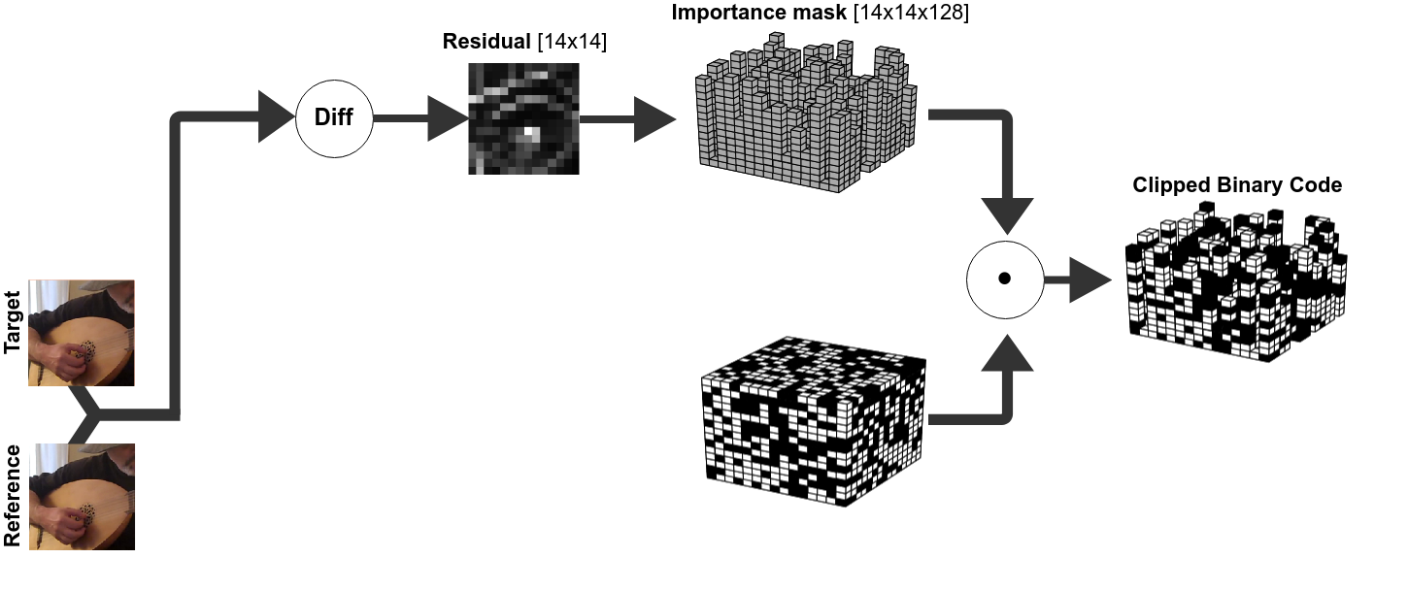

Slide 22
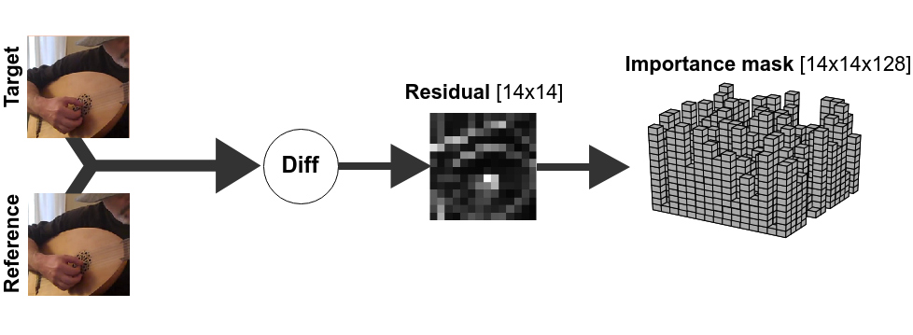
Motion Compensating Importance Mask
Most groups of pixels are unchanged between the target and reference and do not need the full 128 bits to represent them.
Each pixel in the 14x14 binary feature map represents a 16x16x3 patch in the original image
We take the the residual of the reference and target and use it to define “importance levels” to restrict bit allocation for further compression.
Notes:
What is an importance level?
How are importance levels calculated?
How are they distrubted

Slide 23
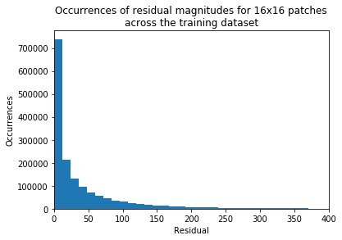
Importance Levels
We arbitrarily assign 64 distinct importance levels
Each importance level represents 2 extra bits of representation
We chose an arbitrary cut-off line at 128

Slide 24




The math
k
j
i

Slide 25
Clippining the Binary Code
Once the importance mask is calculated, perform pairwise multiplication across the binary code
This has the benefit of reducing the amount of information received by the decoder about the input image
Compression can be controlled by the depth of the binary code, and the aggressiveness of the importance mask.

Slide 28
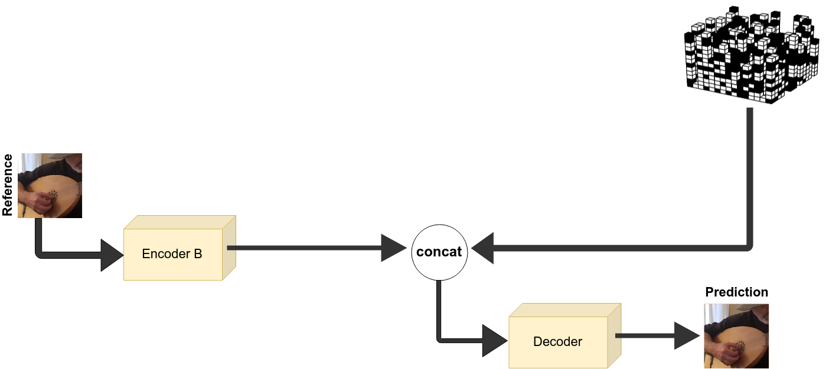
Encoder B & the Decoder
Encoder B Purpose:
Learn reference features from which to reconstruct the target image
Decoder Purpose:
Upsample binary feature map and generate target image prediction

Slide 29
Encoder-B Architecture
Reference [224x224x3]
Residual Layer
112x112x128
Conv2d [4x4]
Residual Layer
56x56x128
Conv2d [4x4]
Residual Layer
28x28x128
Conv2d [4x4]
Residual Layer
14x14x128
Conv2d [4x4]
Residual Layer
Notes:
Residual Layer
ResNet50
FlowNetCorr (and intuition)

Slide 30
Decoder
14x14x128
28x28x128
28x28x128
112x112x128
224x224x3
Depth 2 space
Depth 2 space
Depth 2 space
Reference Features
Depth 2 space
Target Prediction
Binary Code
Residual Layer
Residual Layer
Residual Layer
Residual Layer
Residual Layer

Slide 31
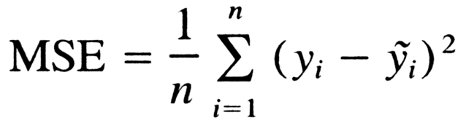
Loss Function
It’s worth noting that there are serious problems with using mean squared error as a loss function for optimizing image generation problems. It tends to lead to blurry, low quality images because of assumptions it takes about the distribution being unimodal.
GANs have recently demonstrated superior performance in this area (i.e. VAEGAN, etc.)

Slide 34
Dataset

Slide 35
The Kinetics Human Action Video Dataset
We selected this dataset because we were interested in highly dynamic scenes with significant motion
Dataset developed and curated by Deepmind
Contains 500,000 video clips sampled from Youtube
Videos span 600 human action classes
At least 600 videos per class
At least 10 seconds per clip

Slide 36
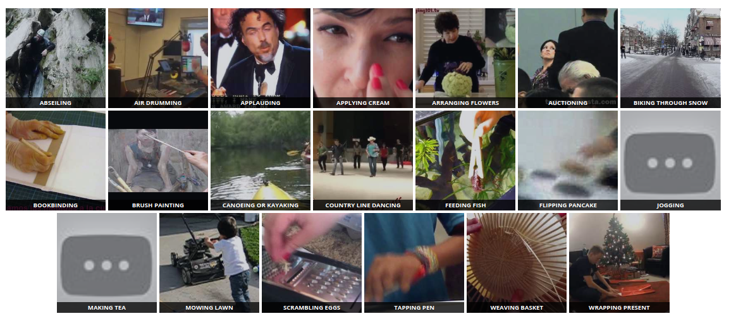
The Kinetics Human Action Video Dataset

Slide 37
Sampling Strategy & Data Statistics
Download each video from the dataset
Randomly select 5 target frames in the video
Randomly select a following frame anywhere between 1 to 5 frames away (to ensure a mix of large and small translations in the dataset)
Create a training example from the target/reference pairs
The training set has 10,000 target/reference pairs
The testing set has 10,000 target/reference pairs

Slide 38
Results

Slide 39
Results Table: PSNR
 | Encoder
 | Simple Residuals | ResNet50 | FlowNetCorr
Mean PSNR | 31.529 | 30.136 | 29.542
Median PSNR | 31.045 | 29.598 | 29.067
Max PSNR | 73.606 | 58.9998 | 63.695
Min PSNR | 16.650 | 15.4168 | 13.036
Std. PSNR | 5.5695 | 5.519 | 5.329

Slide 40
Results Table: SSIM
 | Encoder
 | Simple Residuals | ResNet50 | FlowNetCorr
Mean SSIM | 0.8947 | 0.8568 | 0.8616
Median SSIM | 0.9100 | 0.8794 | 0.8841
Max SSIM | 1.00 | 1.00 | 0.9996
Min SSIM | 0.391 | 0.201 | 0.1920
Std. SSIM | 0.0732 | 0.102 | 0.1002

Slide 41
With & Without Importance Map
 | With Importance Map (ResNet50) | Without (ResNet50)
Mean PSNR | 30.136 | 28.506
Median PSNR | 29.598 | 27.967
Max PSNR | 58.9998 | 86.420
Min PSNR | 15.4168 | 9.970
Std. PSNR | 5.519 | 6.387
Notes:
It’s a little bit counter intuitive that MORE compression leaders to better results but this actually also helps the network learn the relationship between the input space

Slide 42
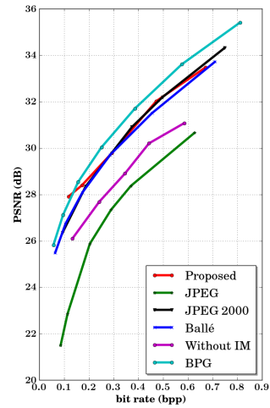
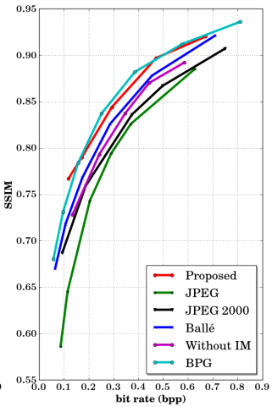
Comparison to Other Results
Comparison to results for image compression on a comparable but different dataset.
The purpose is to demonstrate the reasonable range for the result
= our best result

Slide 43
References

Slide 44
Fischer, Philipp, et al. "Flownet: Learning optical flow with convolutional networks." arXiv preprint arXiv:1504.06852 (2015).
Kay, Will, et al. "The kinetics human action video dataset." arXiv preprint arXiv:1705.06950 (2017).

